Slide 1
UC the Fish: Aquarium Submarine
Team 12: Chelsea Duran, Zack Grbach,
Ben Lorenzetti, Josh Alexander
Advisor: Dr. Fred Beyette

Slide 2
Outline
Problem Statement
Design Process
Assessment Metrics
Design Overview
Project Limitations
Prototype Demonstration

Slide 3
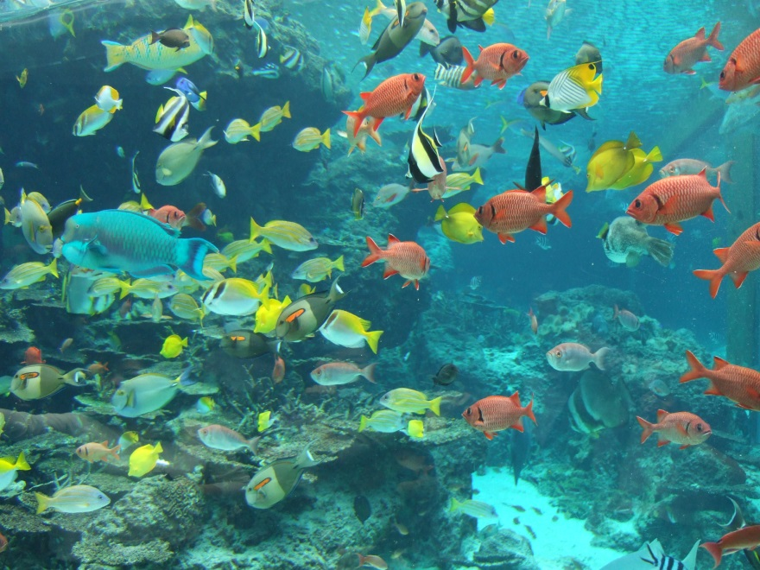
Problem
Over 200 Aquaria
46 Aquariums
Interactive exhibits
Attract visitors
Increase educational success
Engage families
Stay connected

Slide 4
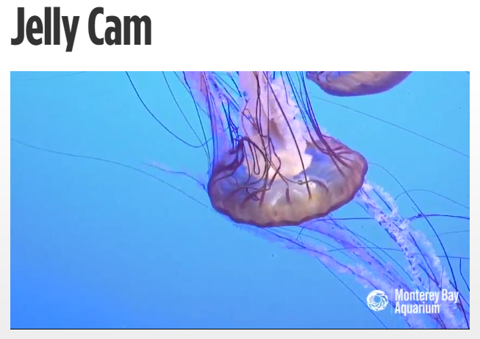
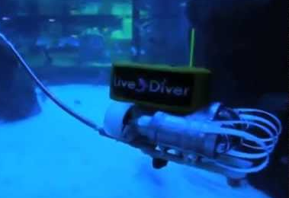
Current Solutions
1. Live Diver
2. Live Webcams
Difficult to maneuver
Tethered
Black and white
Significant lag
Stationary or limited motion

Slide 5
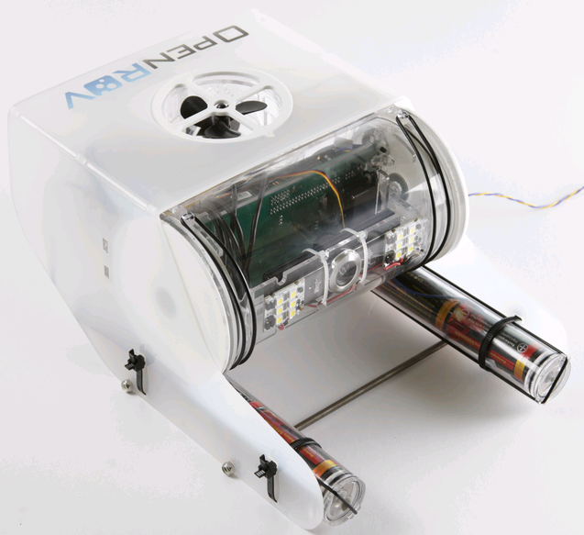
Our Solution
Waterproof Device
Stream Live Video
Wireless communication
Hover in place
Move as desired

Slide 6

Voice of Customer
Surveyed Aquarium Hobbyists
Remote-Controlled Motion (4.44 out of 5)
Live Video Streaming (4.33 out of 5)
Wireless Communication (4 out of 5)
Interviewed Newport Aquarium Operations Manager
Wireless Communication
Set Path
Educational

Slide 7
Objectives
Safe
Fish
Environment
Operational
Controllable Motion
Stream Live Video
Wireless Communication
Durable
Withstand water pressure
Resist salt corrosion
Usable
User interface
Easily Maintenance
Failsafes

Slide 8
Constraints
Fish Safety
Below 20 dB relative to 1uPa pk-pk
Less than 2 kHz
Environment Protection
No toxins
Impact momentum less than 0.0733 m*kg/s
Live Video Streaming
640 pixels by 480 pixels
24 frames per second
Neutrally buoyant
Density ≅ 1.0 g/ml
Waterproof
Video Display

Slide 9
Morph Chart
Function | 1 | 2 | 3 | 4
Video Recording | Webcam | CMOS Camera | CCD Camera | -
Land to Sub Communication | Twisted Pair Ethernet | Sound | Optical "LiFi" | -
Sub to Land Communication | Twisted Pair Ethernet | Sound | Optical "LiFi" | -
Waterproof Vessel | OpenROV Shell | PVC | Glass Bottle | Large Jug
Degrees of Motion Control | OpenROV Design | Helicopter | Hubble | -
Motion Actuators | Step Motors | Brushed DC Motors | Brushless DC Motor | -
Actuator Drivers | H-bridge | Power Opamp | Integrated | -
Knowledge of Surroundings | Any Environment | Known Shape of Tank | Tank Designed to Help | -
Position Feedback | Active Sonar | Passive Sonar | Gyroscope, Accelerometer | Light Processing
Motor Control | BeagleBone | Arduino Mega | FPGA | Raspberry Pi
Video Processing | BeagleBone | Arduino Mega | - | -
Power | Batteries | Tethered | - | -
User Interface | Web interface | Preplanned Route | Local Server | -
NOTE: Transparent Black Box Diagram on additional slides and Extended Morph Chart in DHF

Slide 10
Original Requirements
Function | Performance Specification
Display Video | The video display will match resolution of video stream and in frames per second
Control Interface | Controls will match the motion controls available on the submarine
Motion of Device | Design will have actuators capable of moving the device in a 3-coordinate plane
Control of Device | Design must analyze input from users, feedback from current location, and appropriate controls
Live Streaming | Design must be capable of transmitting video data from submarine to land station in real time
Video Capture | Design must have video camera and video compression capabilities
Still Photo Capture | Still photo capture should be offered with resolution greater than or equal a single video frame

Slide 11
Assessment Metrics
All constraints MUST be met
Objectives/Constraints |  | Metrics
Safe | Fish Safe | Does not injure or kill aquatic life
 | Environment Safe | Does not damage aquarium's glass or decorations
Operational | Motion is controlled | Three dimensions of motion with control feedback
 | Wireless | Communication without tether in fresh and saltwater
 | Stream Live Video | Streams a data feed with quality that meets listed constraints
 | Still Photo Capture | Capture high definition resolution pictures (1080p)
Durable | Resist Salt Corrosion | No visual damage after 20 hours of operation
 | Withstand Water Pressure | Water tight at a minimum of 32 psi
Usable | Easy Maintenance | Minimum of 30 day period between routine maintenance
 | Camera free of debris | No visual debris after 10 hours of operation
 | Fail safes | Shuts down safely in the occurrence of a water leak
 | User Interface | Contains video display
 | Operate in Open Waters | Can control and retrieve in open waters

Slide 12
Design Alternatives
Compared through Best-in-Class Chart
NOTE: Charts shown on additional slides
Weighted Results:
Optical and sound communication with openROV vessel (59.233)
Optical and sound communication with PVC vessel (57.133)
Two-way optical communication with openROV vessel (54.45)

Slide 13
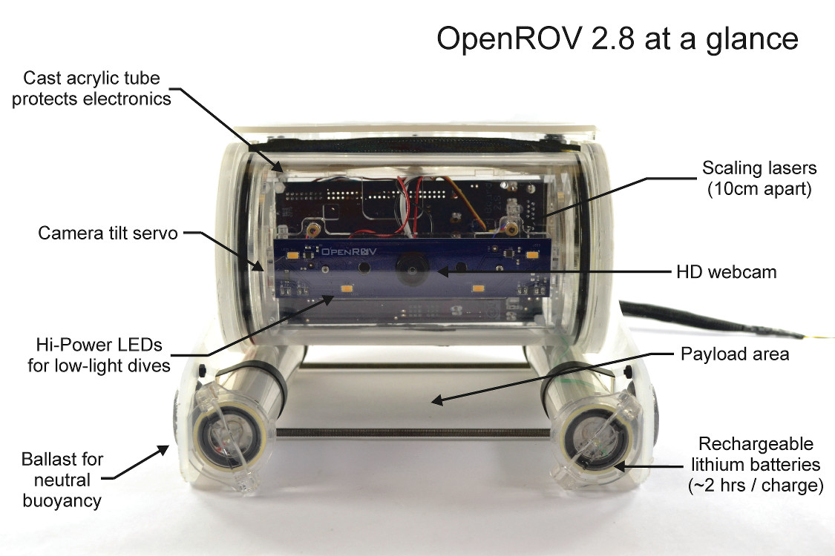
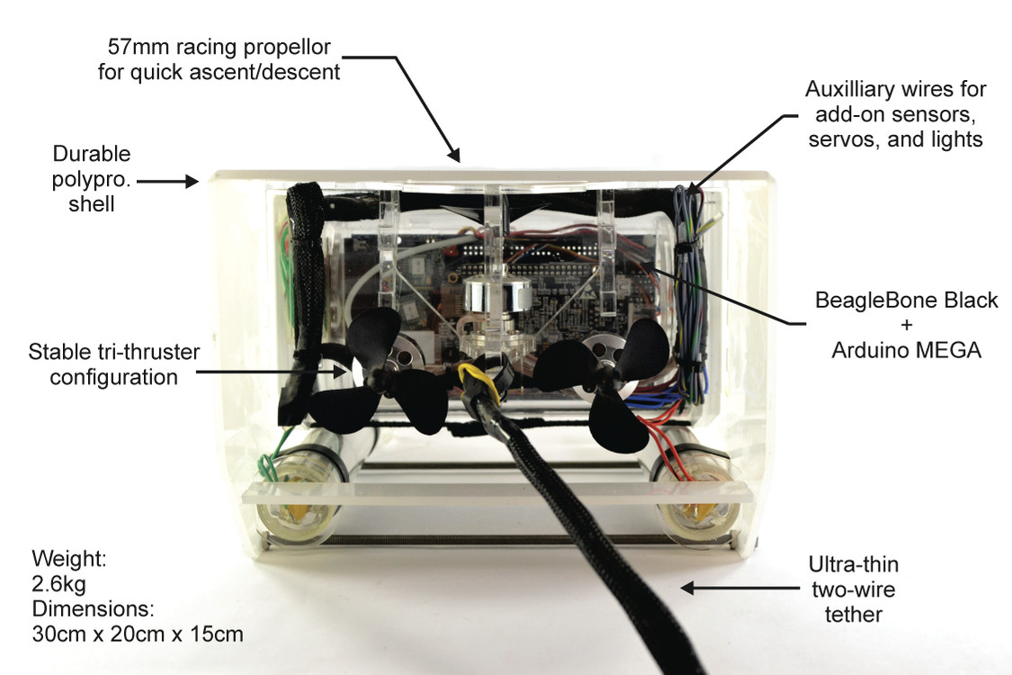
OpenROV V2.8

Slide 14
Test Plan
Test Protocol 1.1: Modular Optic Communication
Switch Tether with Optical Communication Boards
Rate Process on Likert Scale
Test Protocol 1.2: Control of Device & Live Video Streaming
Complete Underwater Obstacle Test with
Tether
Optical Communication
Compare Results
NOTE: Complete Test Protocols in DHF

Slide 15
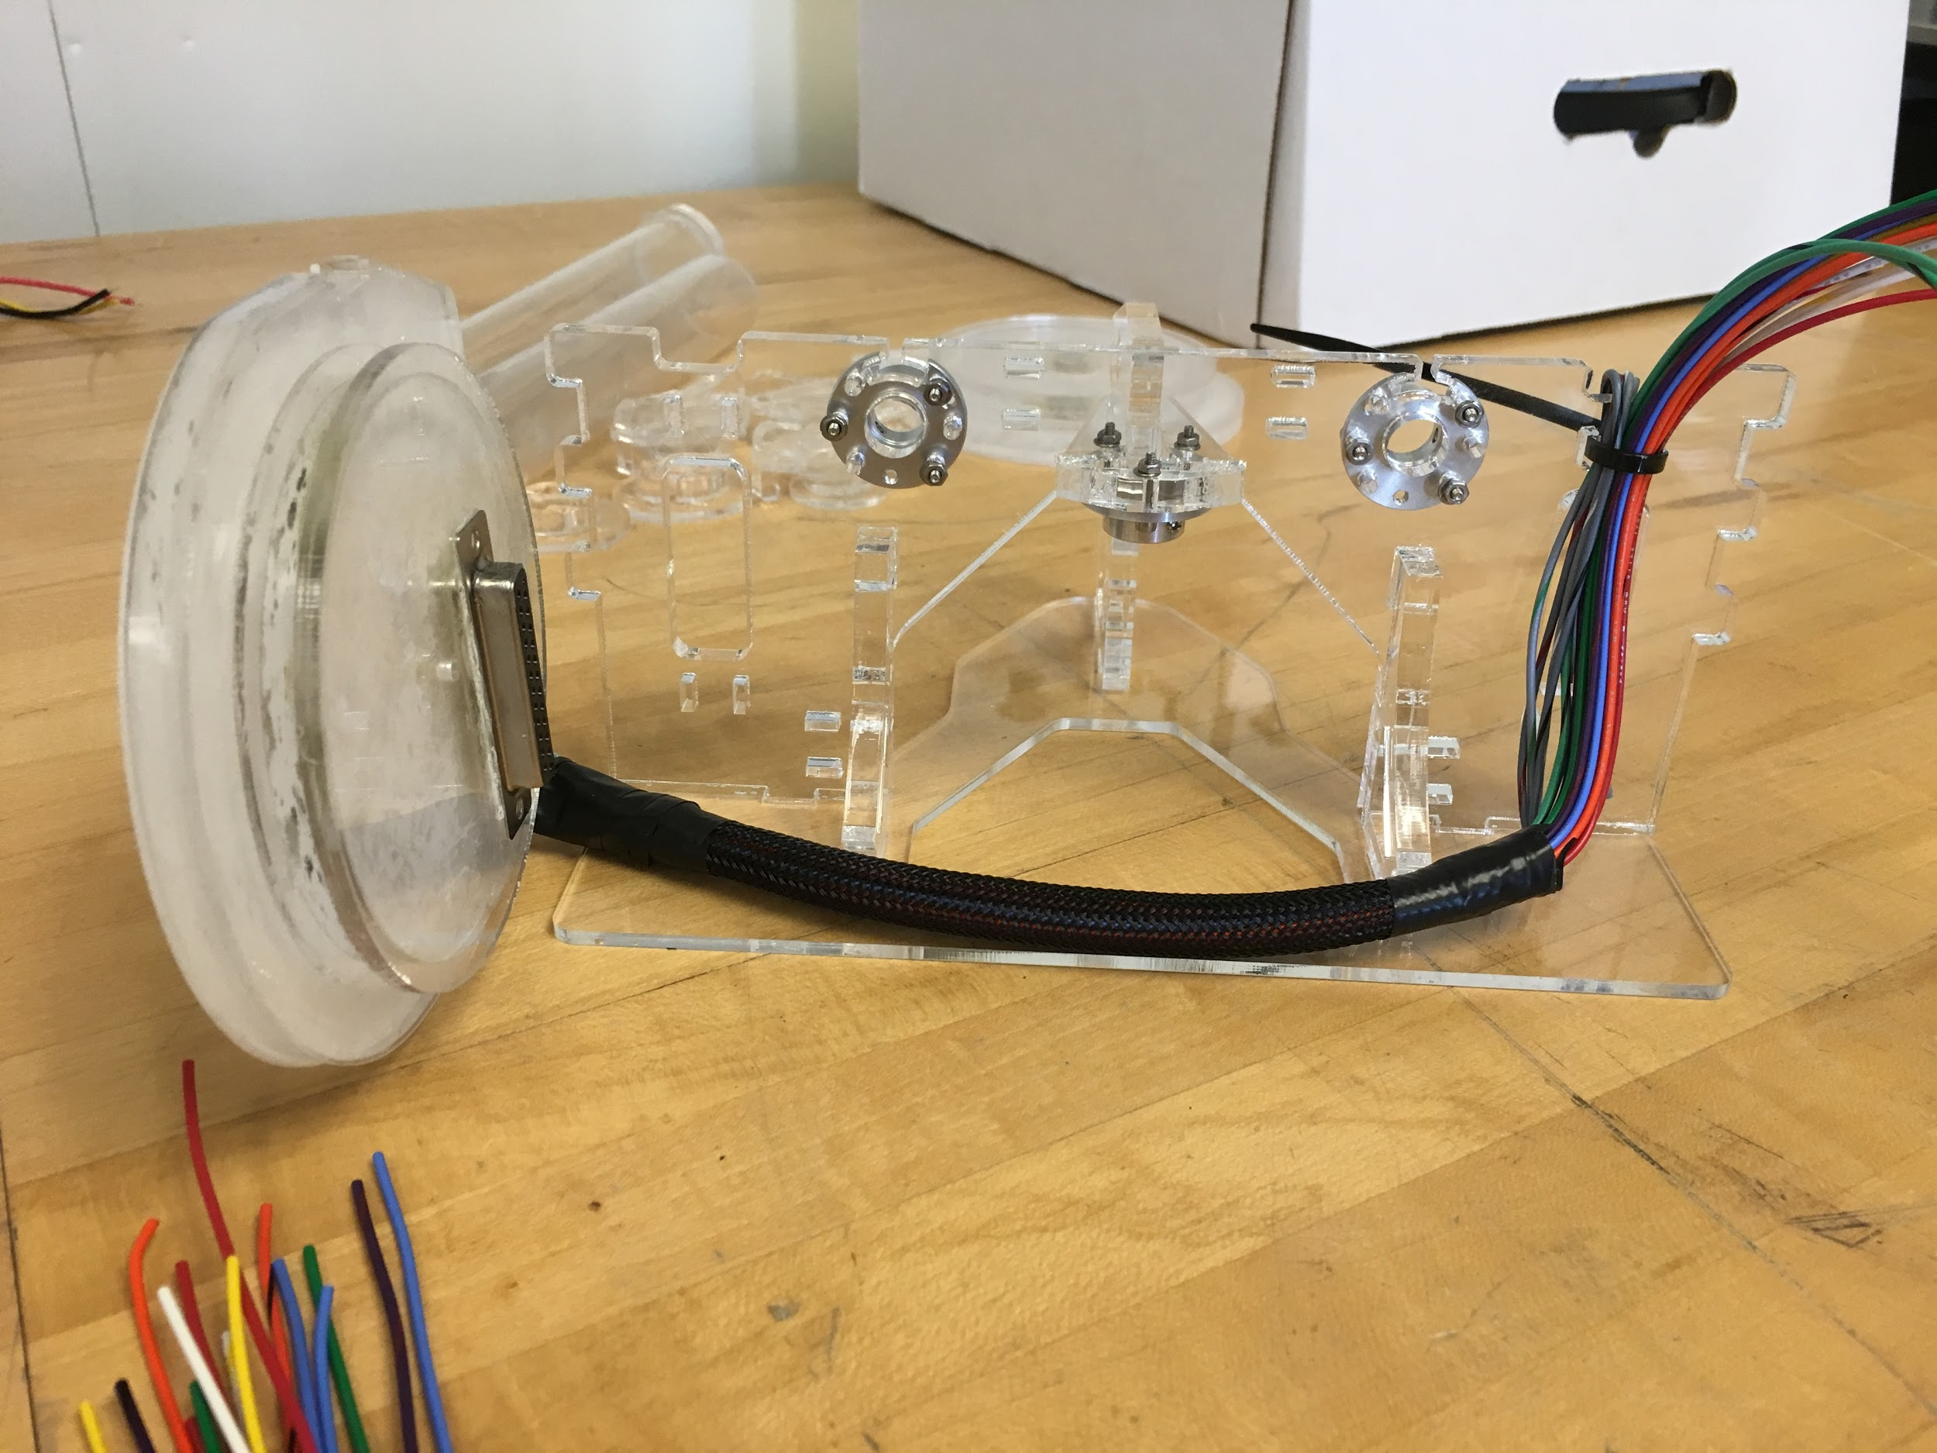
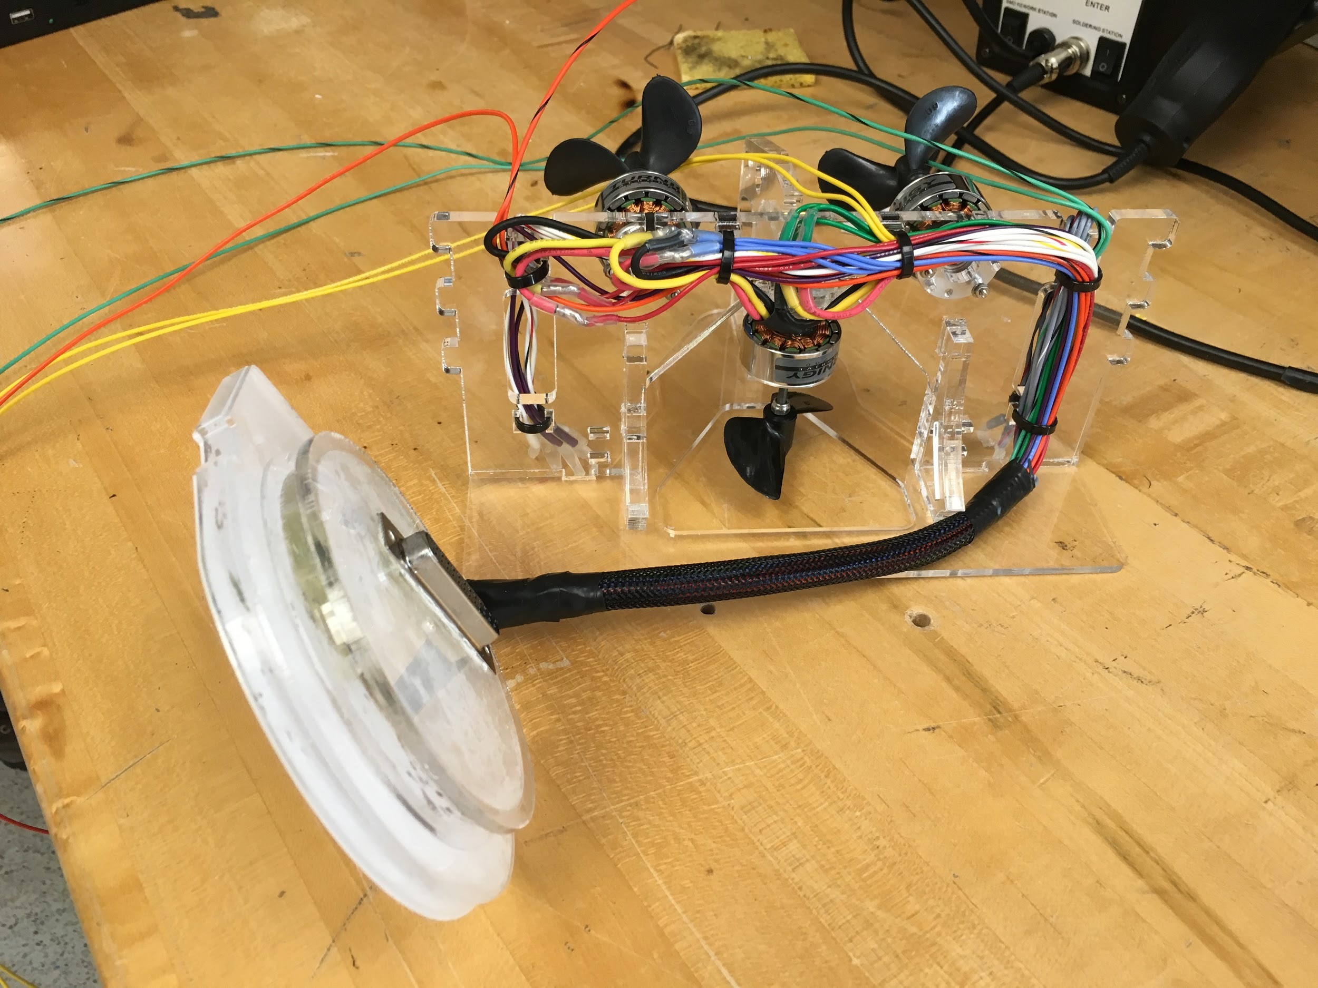
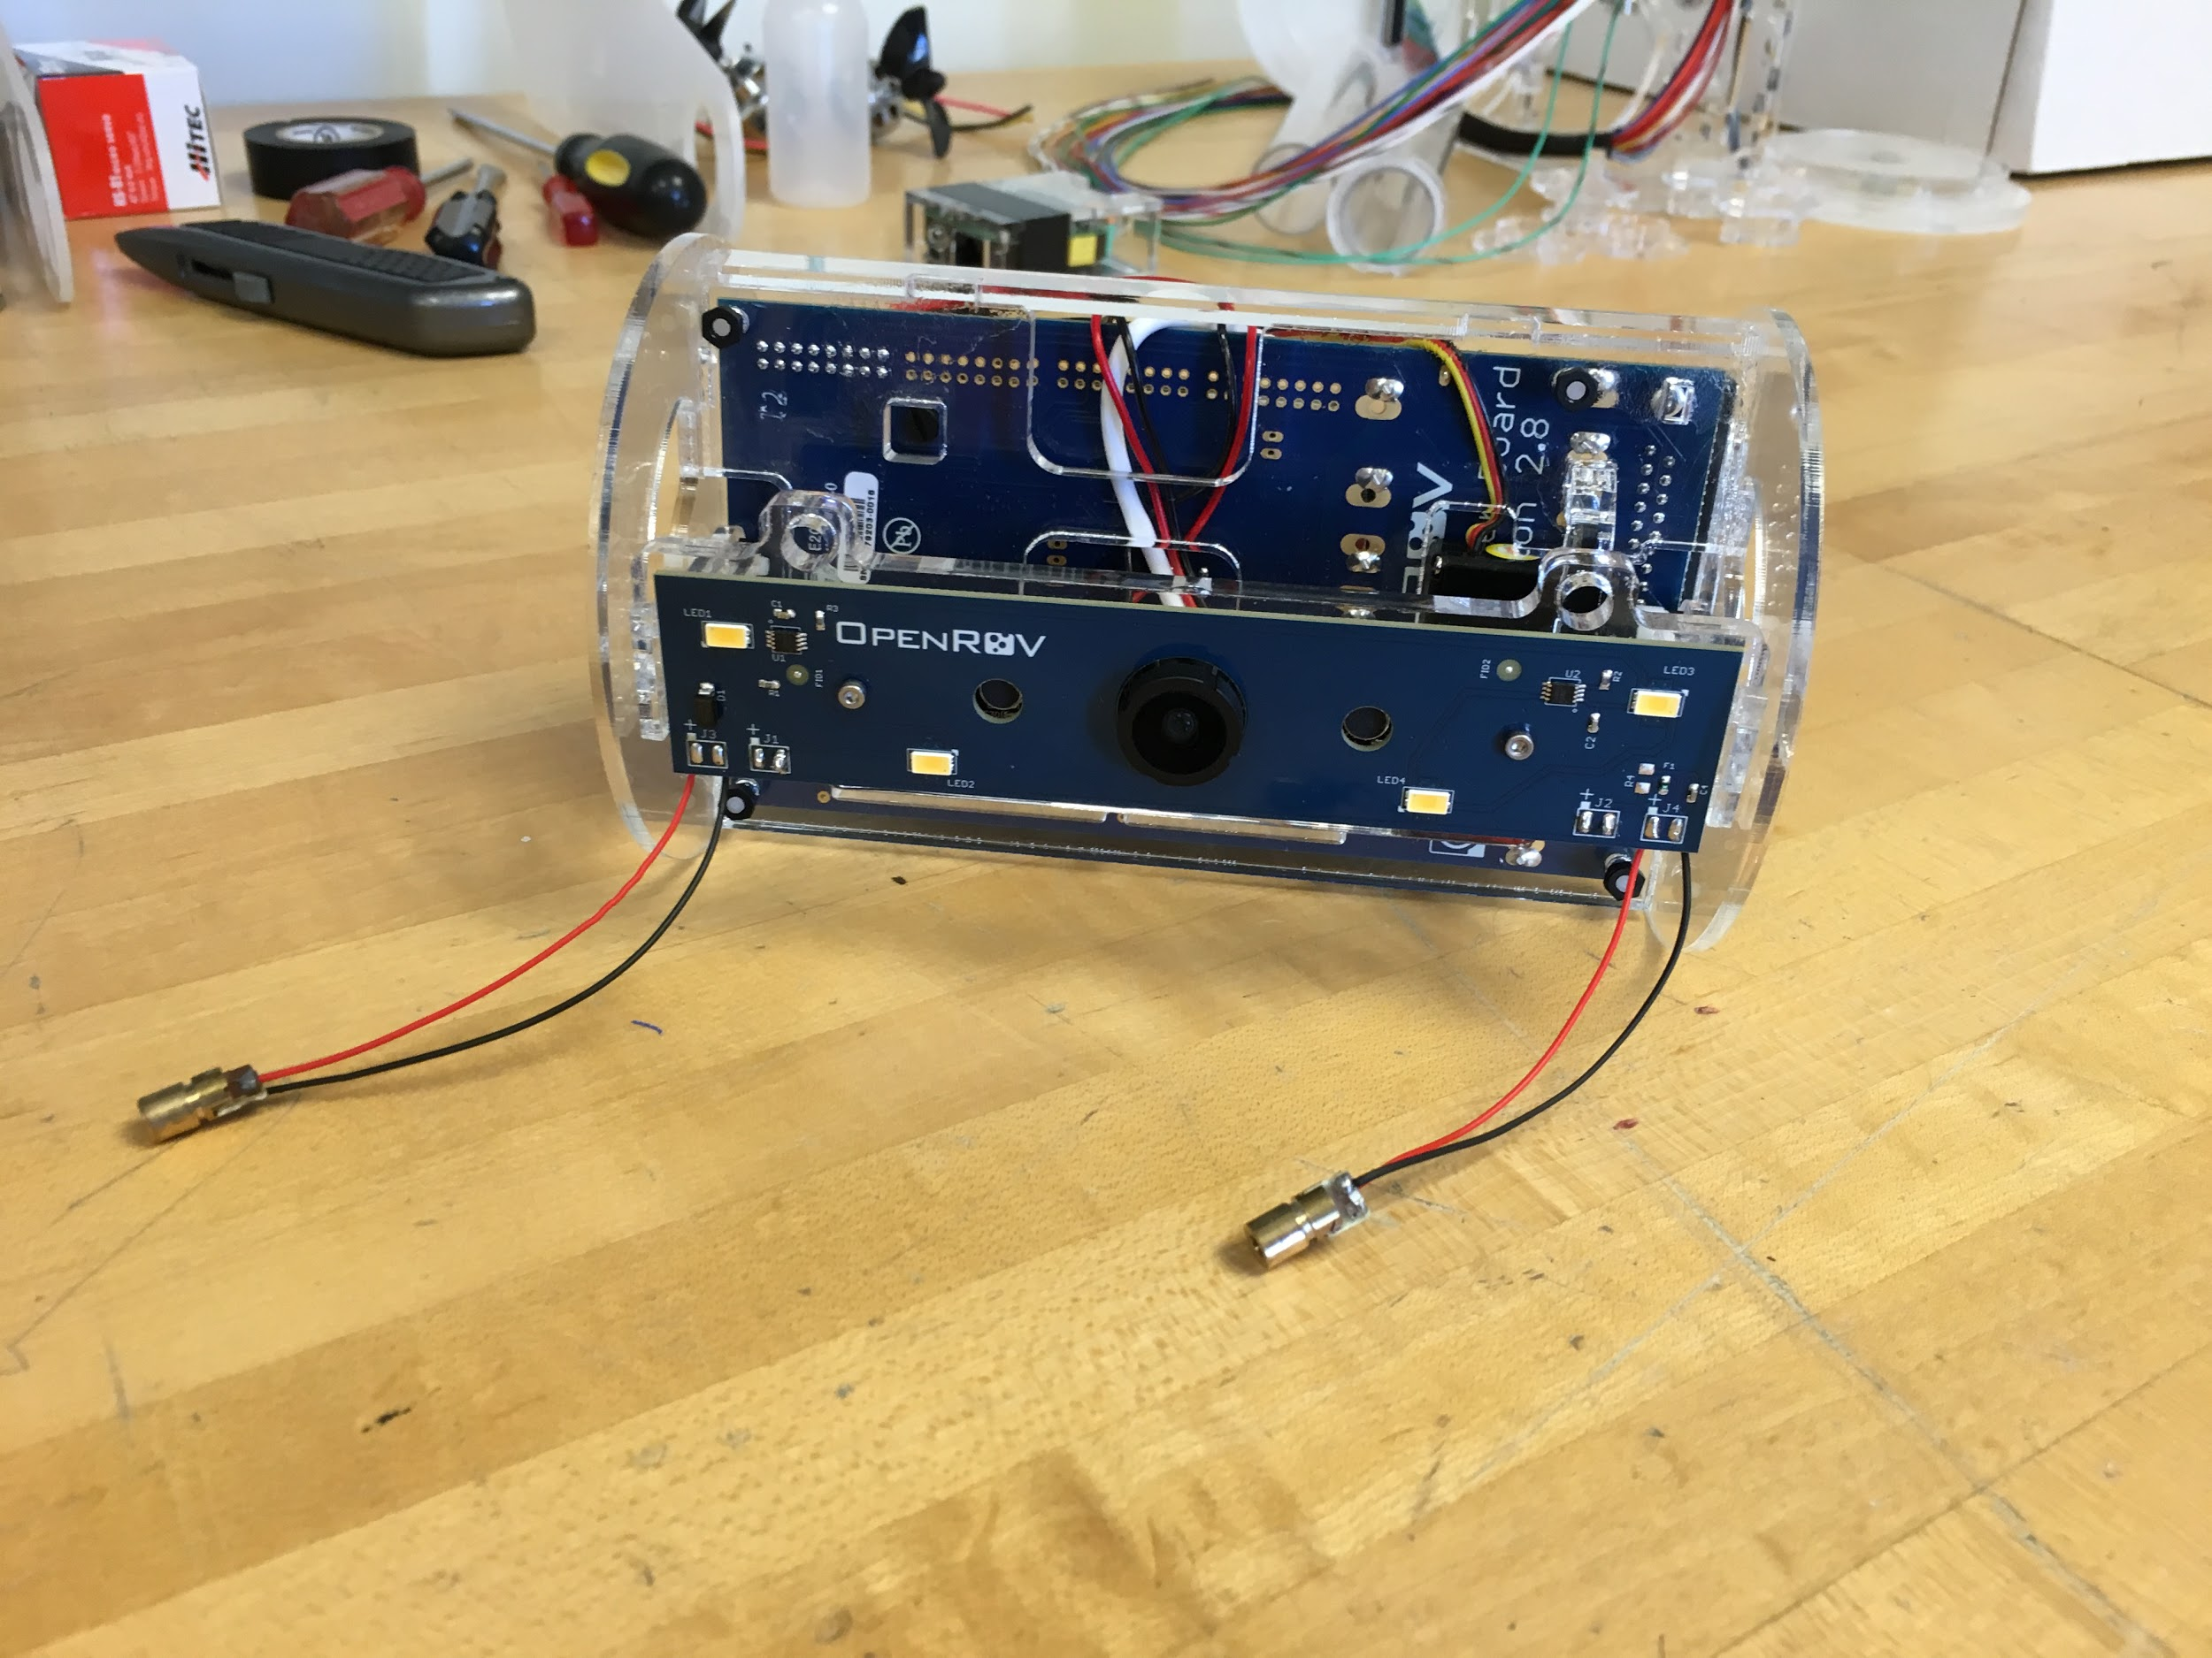
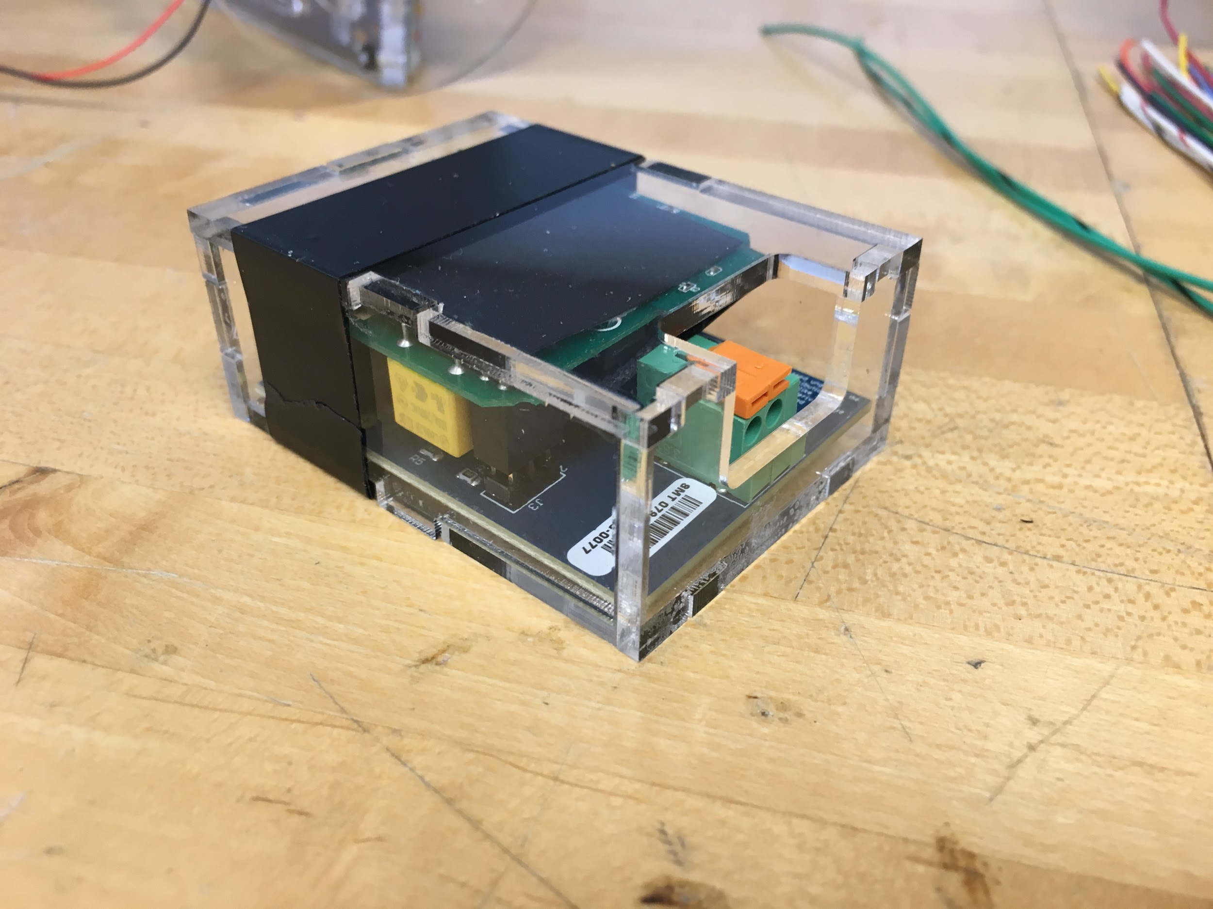
OpenROV Construction

Slide 16
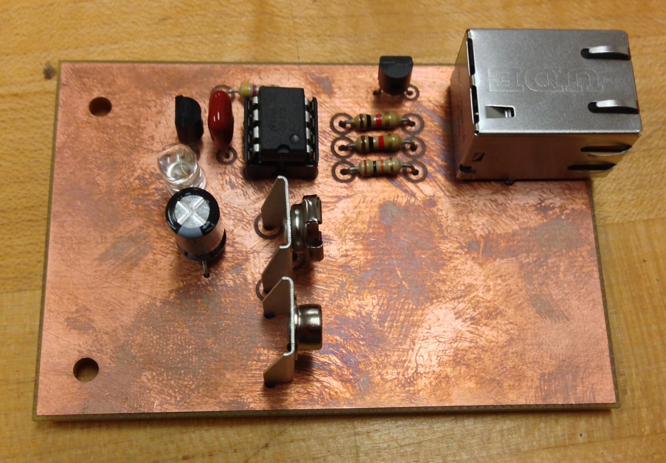
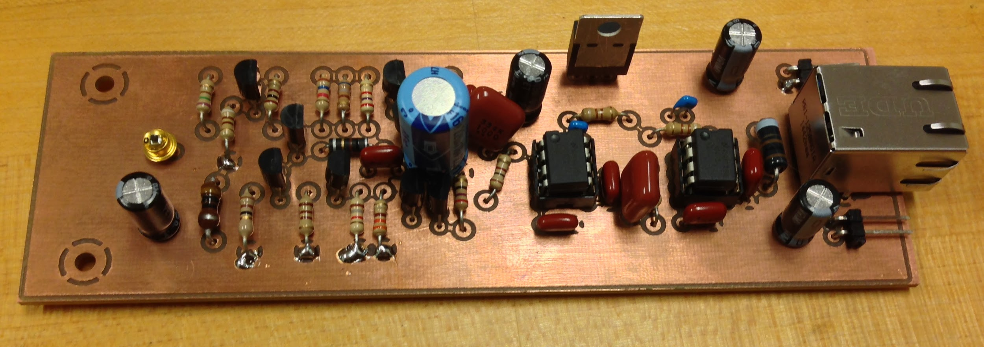
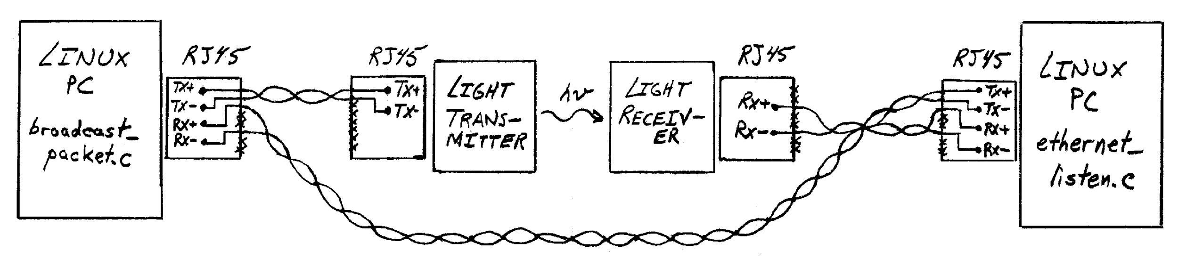
Design Overview

Slide 17
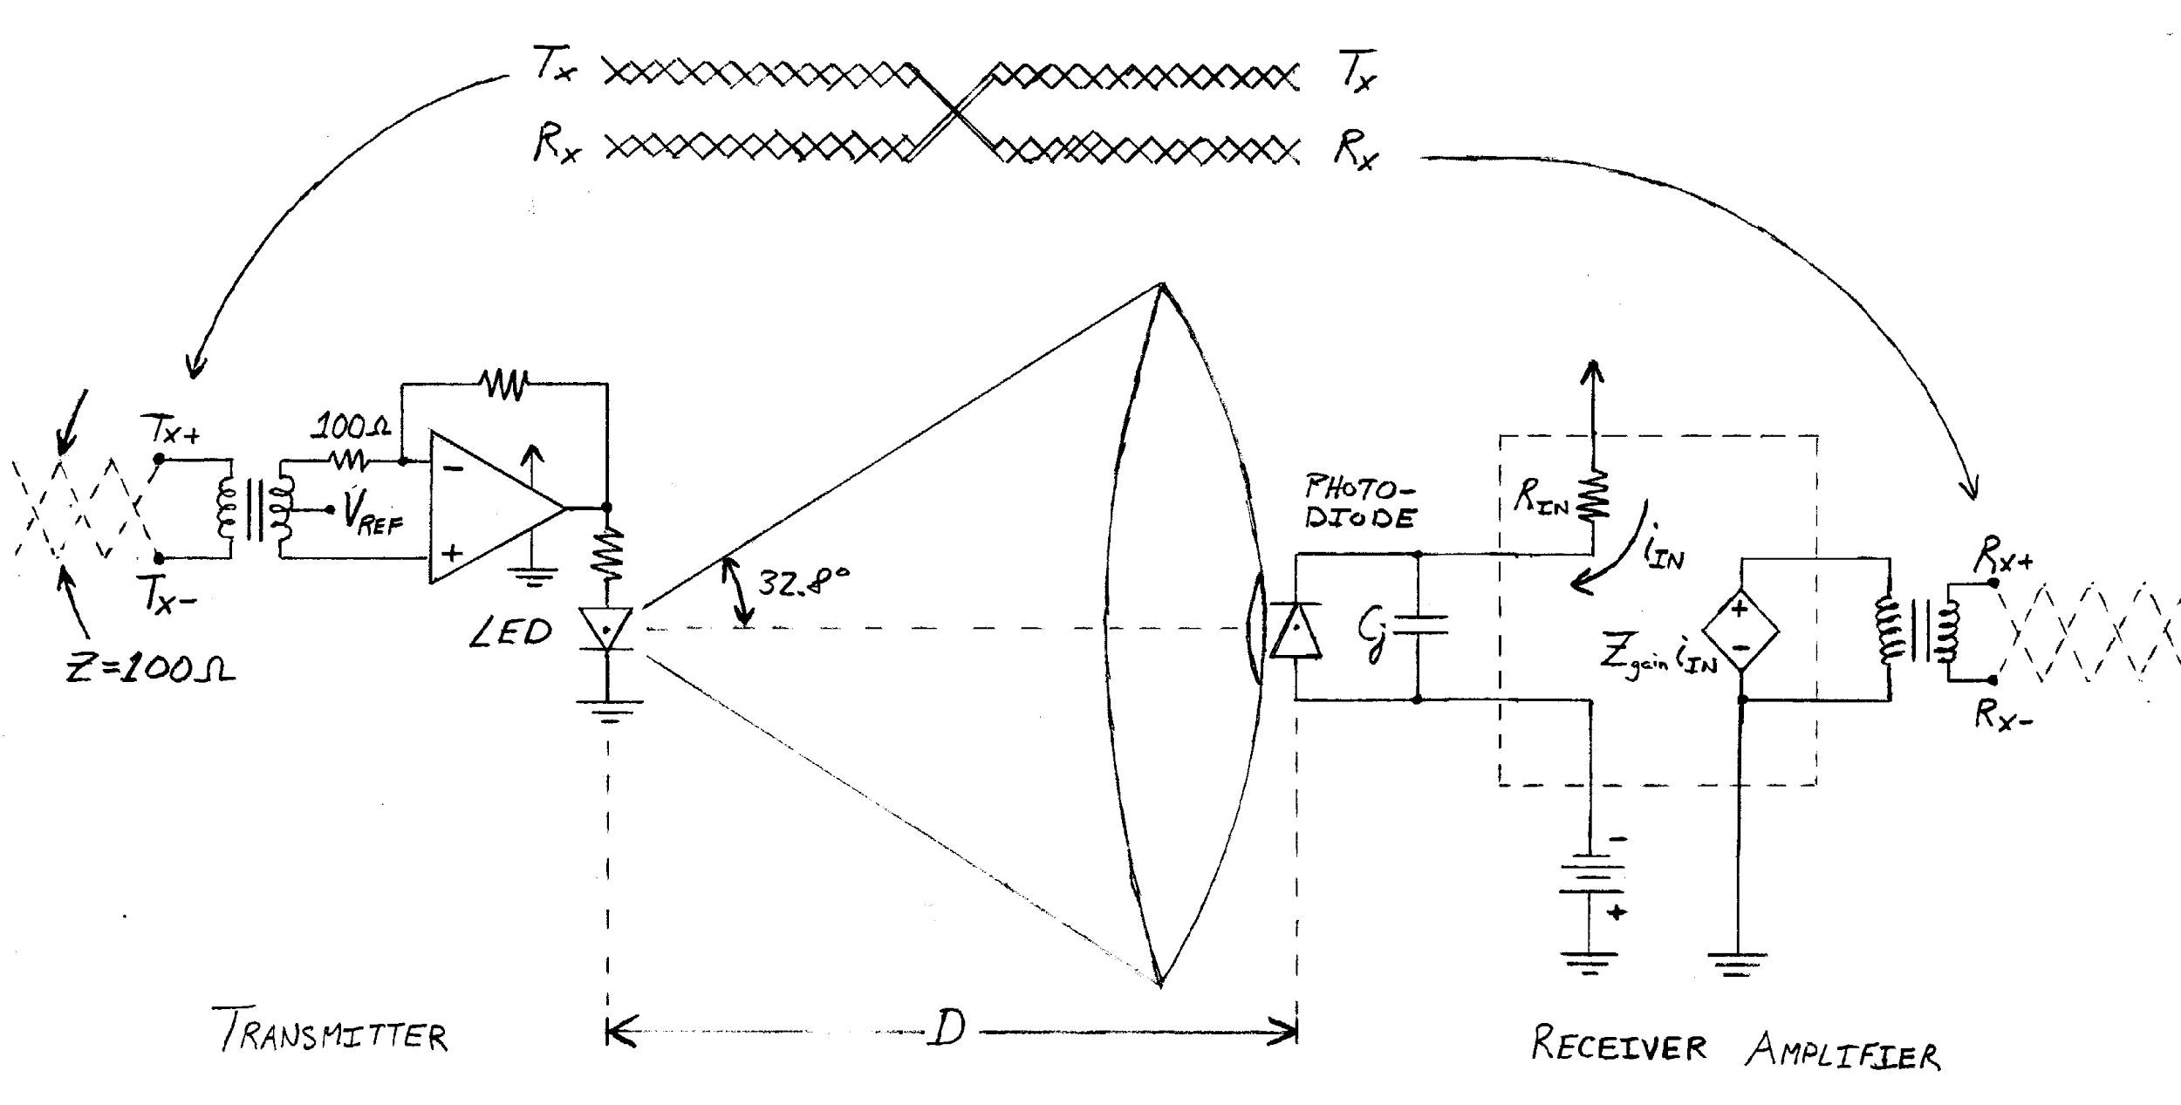
Optical Communication

Slide 18
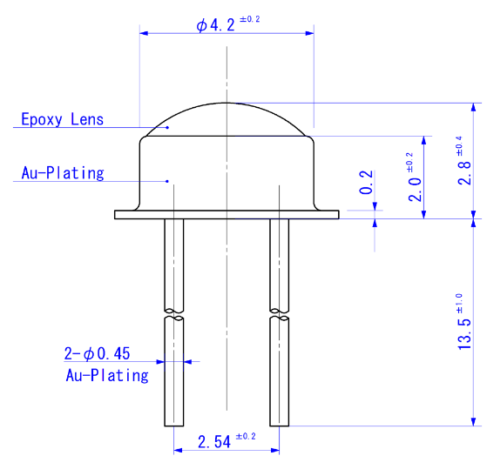
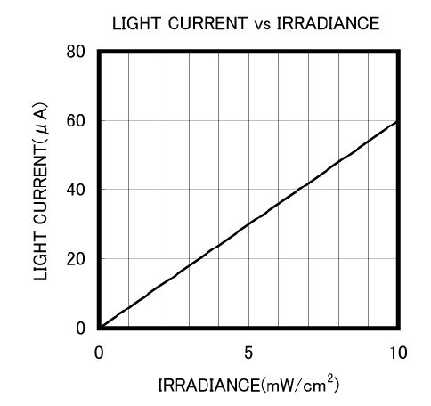
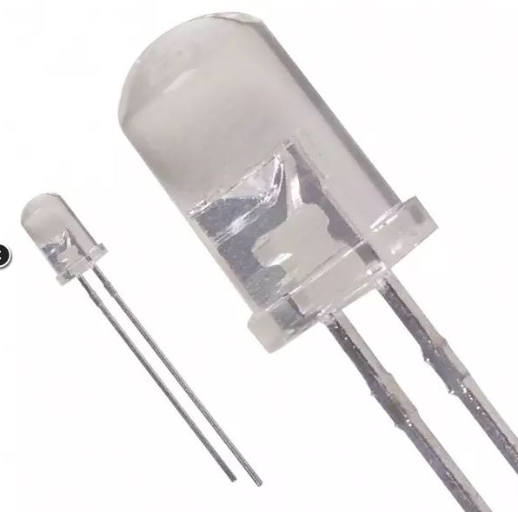
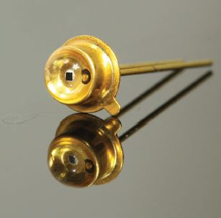
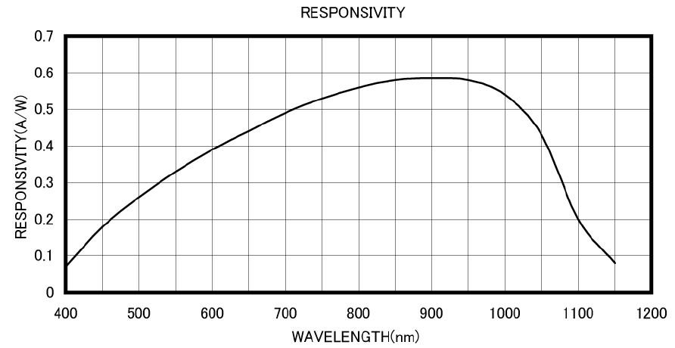
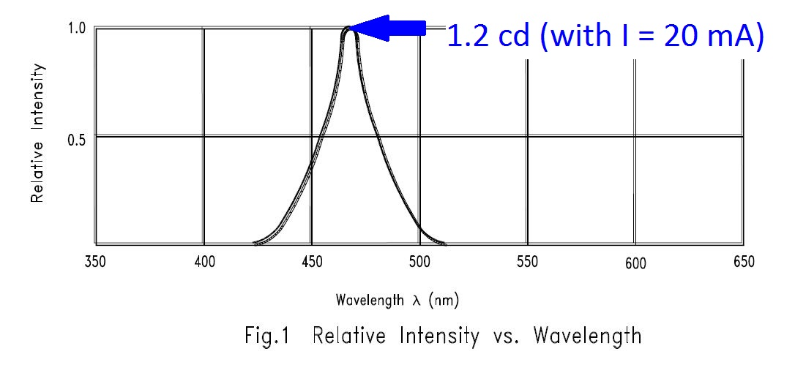
Optic Requirements
20 mA
3. Photodiode Active Area
4. Photodiode Irradiance Current
1. Beam spreading (~1/D^2)
2. Blue LED luminous intensity
5. Photodiode Spectral Responsivity (MTD3010PM)

Slide 19
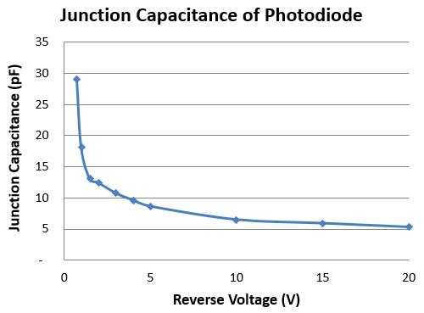
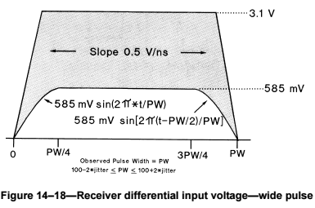
Electric Requirements
8. Parasitic Junction Capacitance
~ 1nA
6. Ethernet T-line impedance matching
(10 MHz ~ 30 m)
7. Ethernet switching Threshold

Slide 20
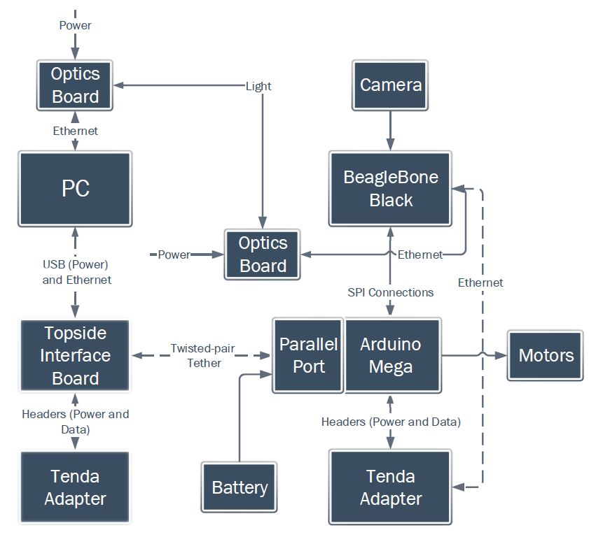
Design Considerations
Despite not being ready for use underwater, optics system was designed to be easily integrated with OpenROV

Slide 21
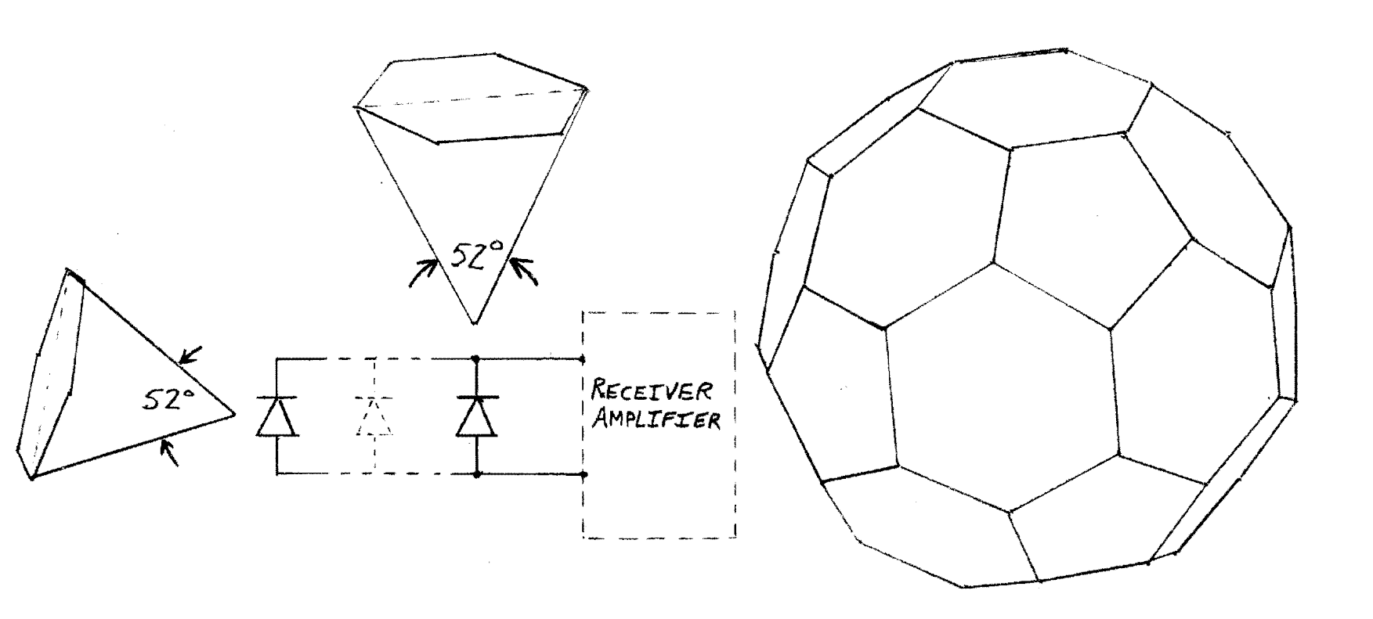
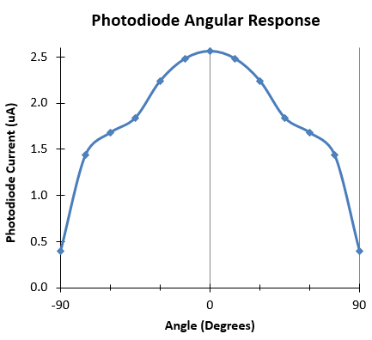

Design Considerations
2. Although not implemented in first
prototype, design supports connecting multiple photodiodes in parallel for omnidirectional receiver

Slide 22
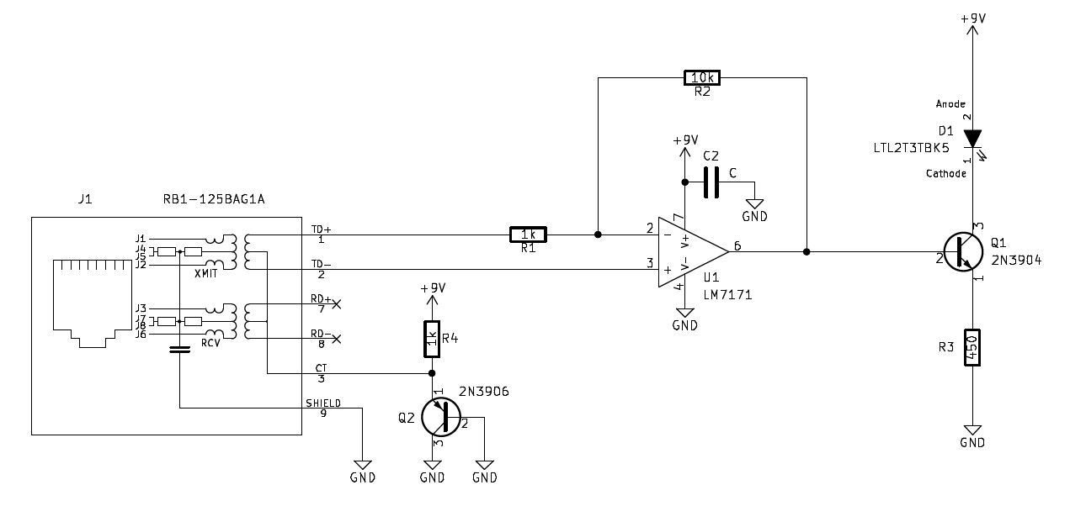
Transmitter (Ethernet -> Optics)

Slide 23
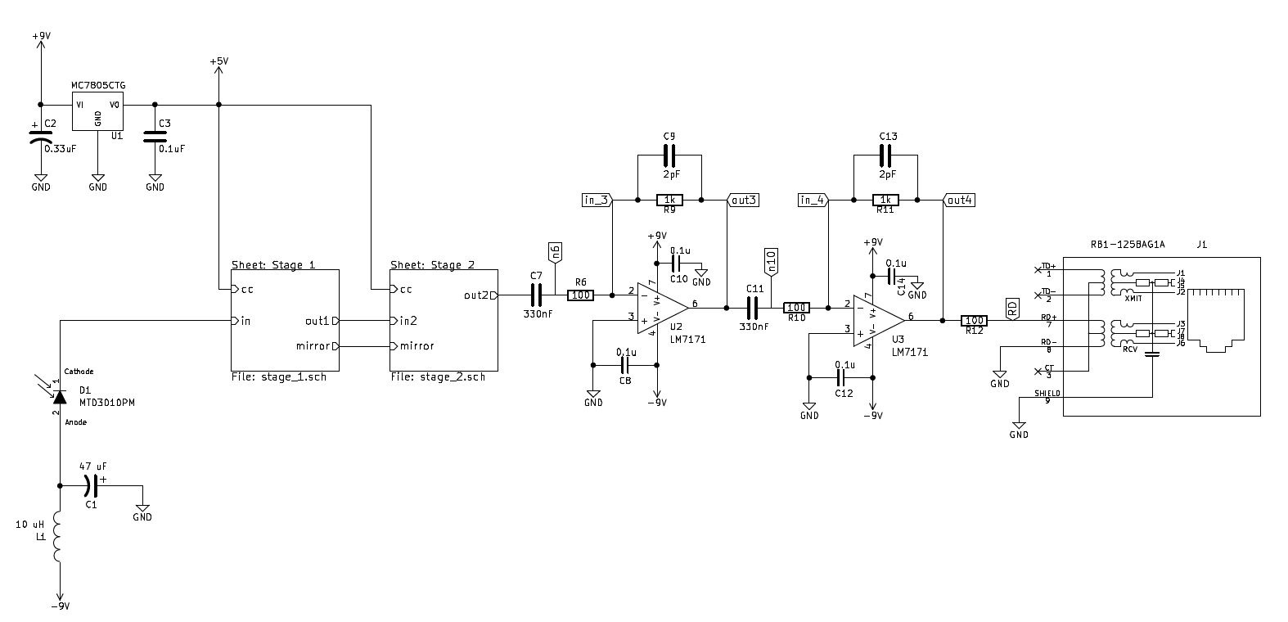
Receiver (Optics -> Ethernet)

Slide 24
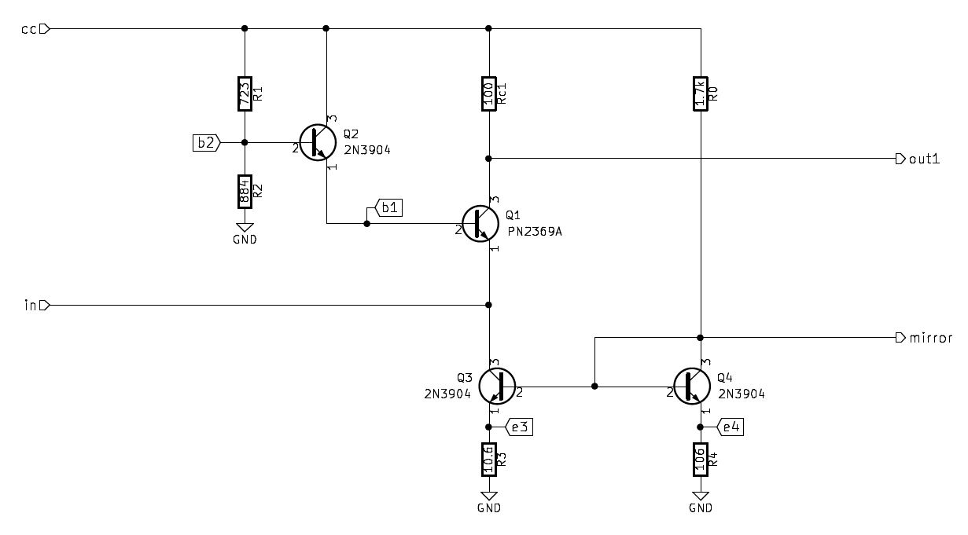
Stage 1 (Common-Base BJT)

Slide 25
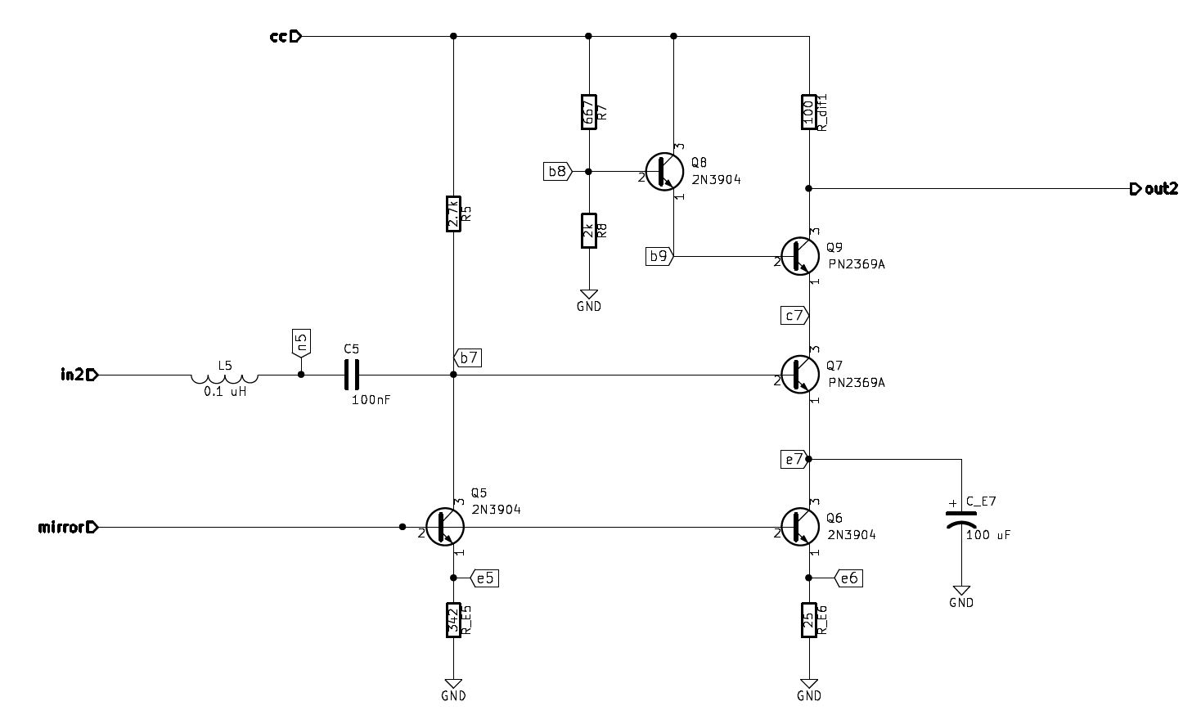
Stage 2 (Common-Emitter BJT)

Slide 26
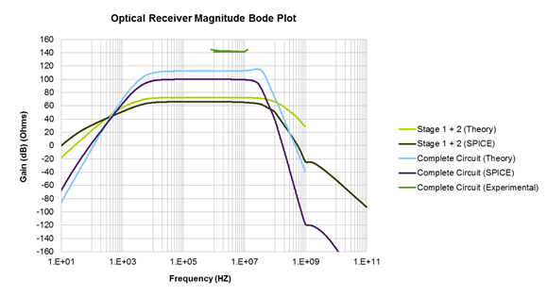
Prototype Operation

Slide 27
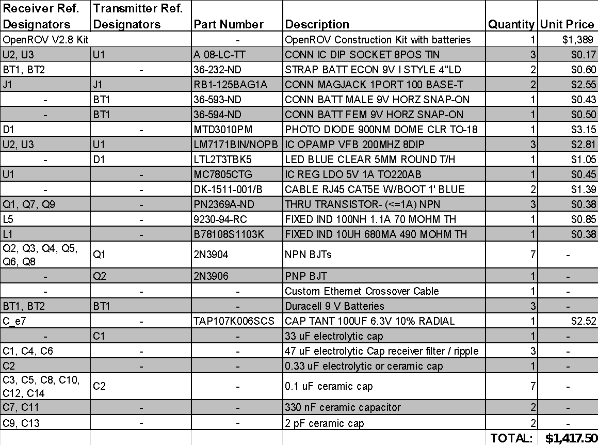
Bill of Materials

Slide 28
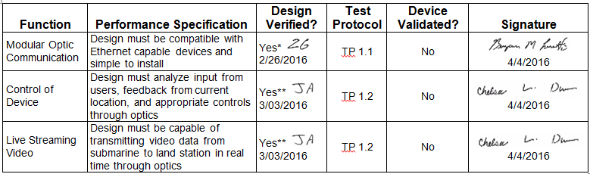
Cascade Matrix
* Connections on the OpenROV located
**Simulations with comparator, light reflection test, and other initial tests.

Slide 29
Project Limitations
Comparator functionality
Will solve variable gain at distance
Dome reflection intensity
Light intensity decreases exponentially (1/r²)
Reflections are constant

Slide 30
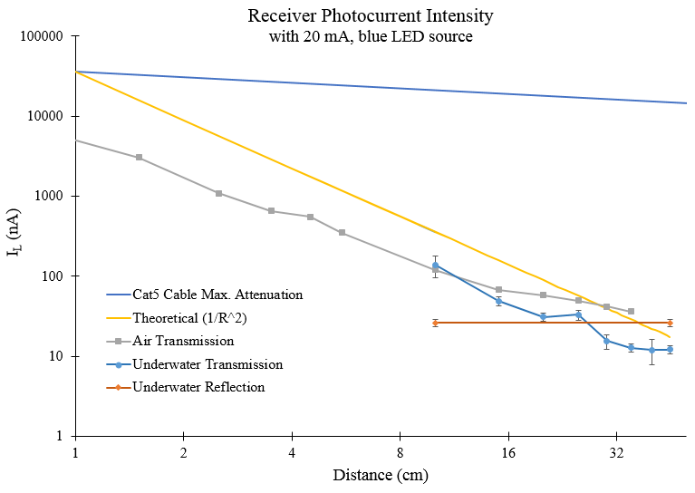
Project Limitations (cont’d)

Slide 31
Project Limitations (cont’d)
Mentioned in Ethernet standards
Need two complete systems to operate
Reflections interfering with protocol
Linear modulation limitations
Angle modulation (phase or frequency) more robust
Need more intelligence for this type of system

Slide 32
Questions?

Slide 33
Prototype
Demonstration

Slide 34
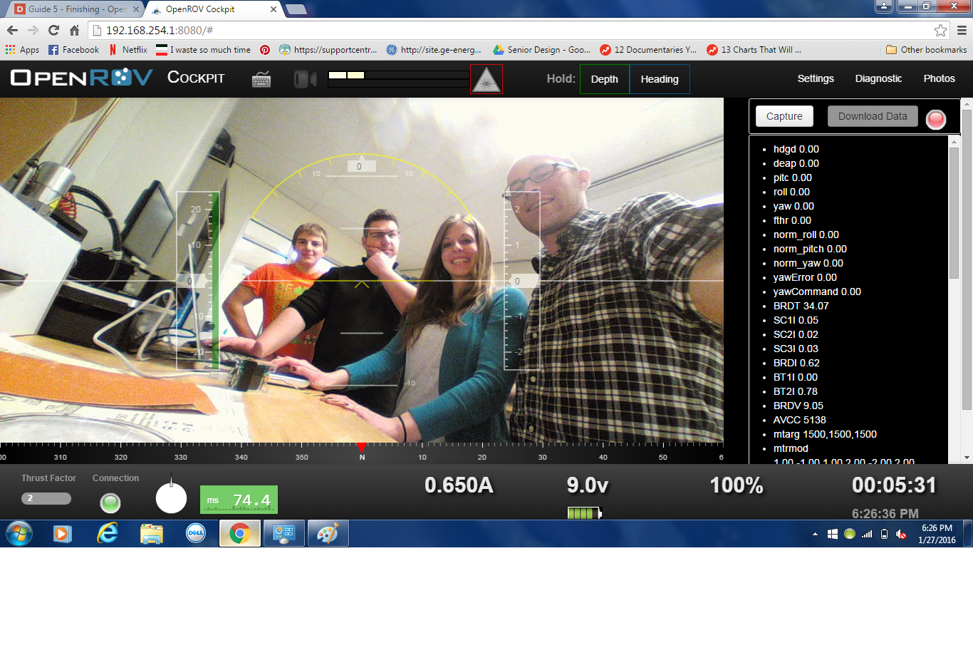

Slide 35
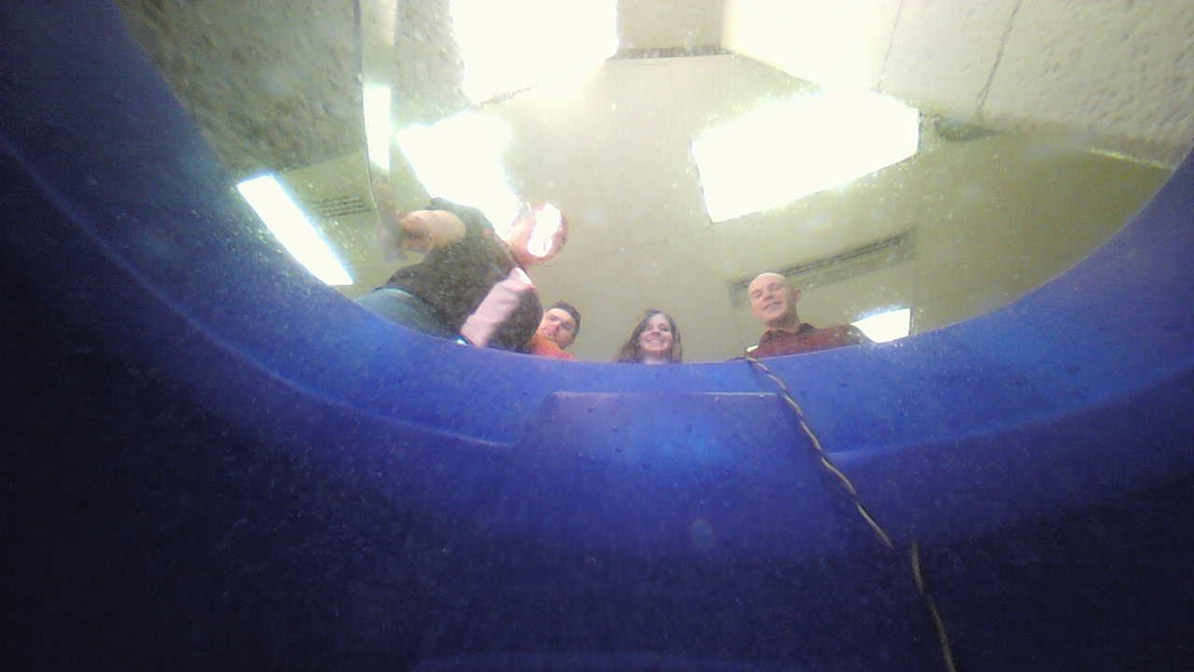

Slide 36
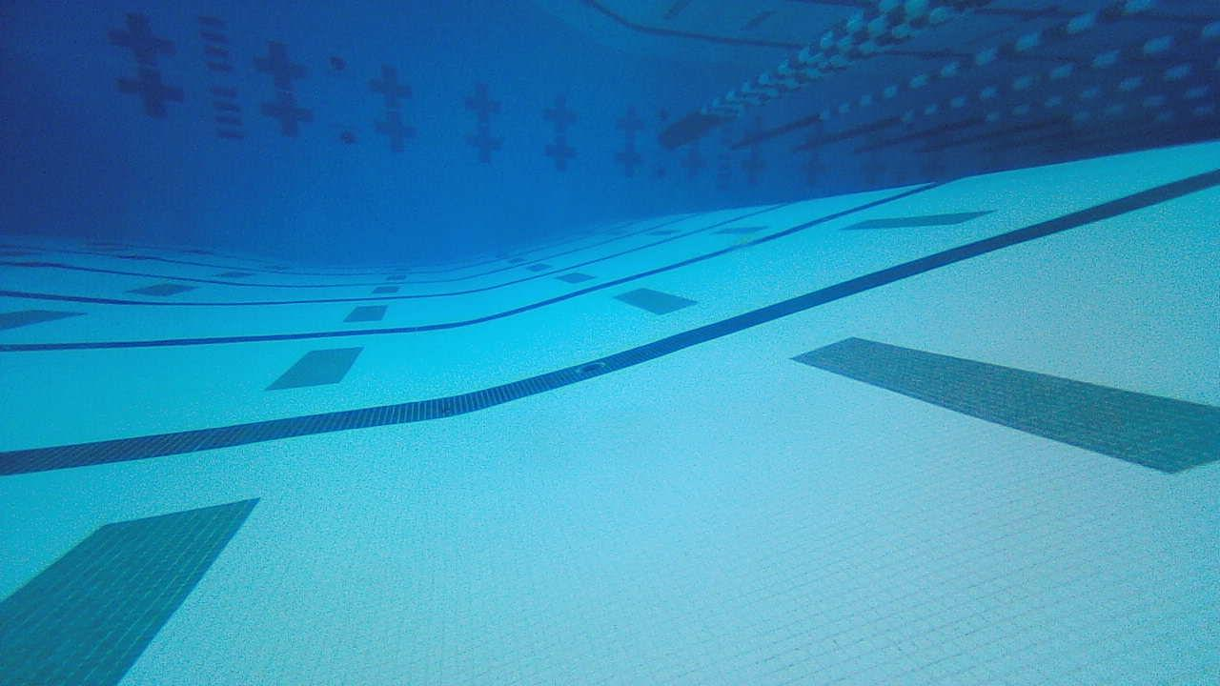

Slide 37
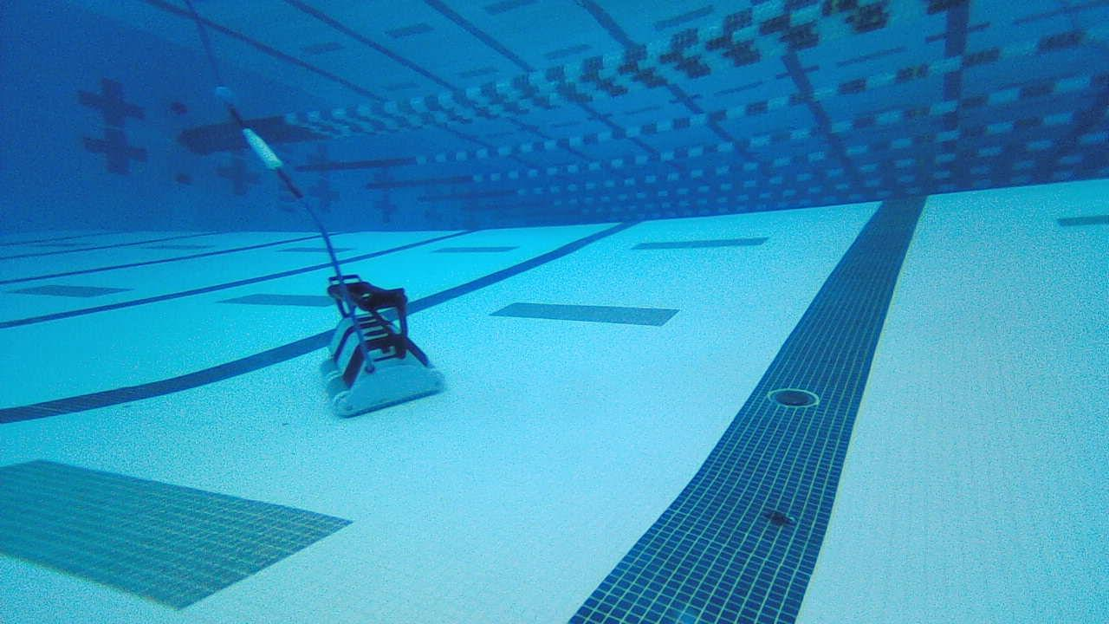

Slide 38
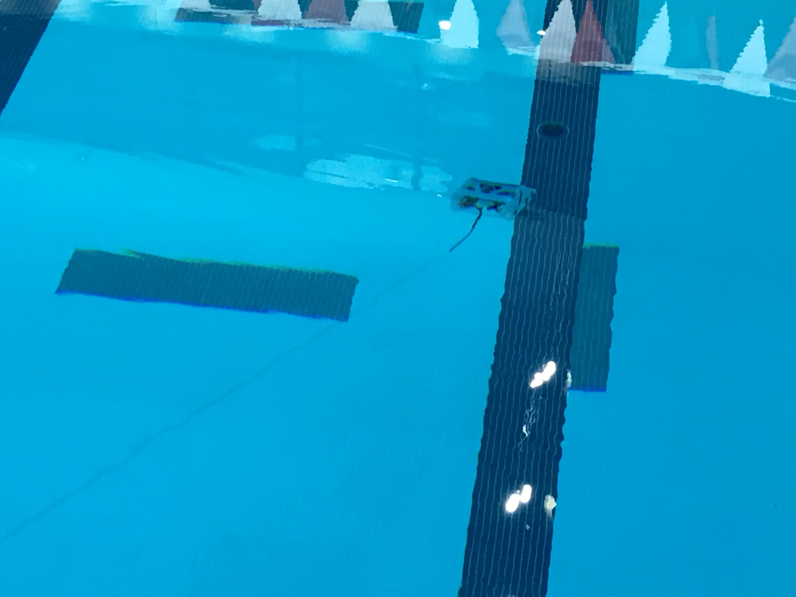

Slide 39
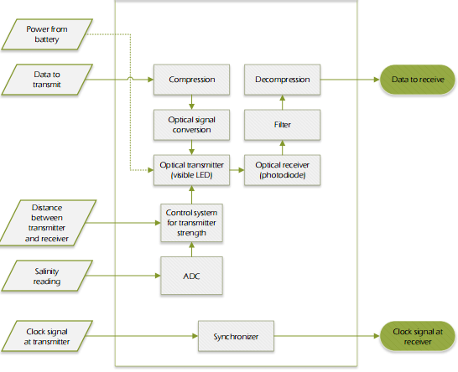
Wireless Video Streaming

Slide 40
Design Options
Design Option: | A | B | C | D | E | F | G | H | I | J | K | L
Power | 1 | 1 | 1 | 1 | 1 | 1 | 2 | 2 | 1 | 1 | 1 | 1
User Interface | X | x | x | X | X | 1 | X | X | X | X | X | X
Video Recording | 1 | 1 | 1 | 1 | 1 | 1 | 1 | 1 | 1 | 1 | 1 | 1
Land to Sea Communication | 2 | 3 | 3 | 2 | 2 | 1 | 1 | 1 | 2 | 3 | 3 | None
Sea to Land Communication | 3 | 3 | 3 | 3 | 3 | 1 | 1 | 1 | 3 | 3 | 3 | 3
Waterproof Vessel | 1 | 1 | 1 | 1 | 1 | 1 | 2 | 2 | 2 | 5 | 4 | 1
Degrees of Motion Control | 1 | 1 | 1 | 1 | 1 | 1 | 3 | 3 | 3 | 3 | 3 | 1
Motion Actuators | 3 | 3 | 3 | 3 | 3 | 3 | 3 | 3 | 3 | 3 | 3 | 3
Actuator Drivers | 3 | 3 | 3 | 3 | 3 | 3 | 1 | 1 | 1 | 1 | 1 | 3
Knowledge of Surroundings | 3 | 1 | 2 | 1 | 1 | 1 | 1 | 1 | 3 | 1 | 1 | 2
Position Feedback | 2 | 4,6,8,10 | 4,7,10 | 5 | 1 | 5 | 5 | 5 | 2 | 3,4,8,9,10 | 3,4,8,9,10 | 3,4,8,9,10
Motor Control | 2 | 2 | 2 | 2 | 2 | 2 | 1 | 4 | 1 | 2 | 2 | 2
Image Processing | 1 | 1 | 1 | 1 | 1 | 1 | 1 | 4 | 1 | 4 | 4 | 1

Slide 41
Design Options
Design Option: | A | B | C | D | E | F | G | H | I | J | K | L
Power | 1 | 1 | 1 | 1 | 1 | 1 | 2 | 2 | 1 | 1 | 1 | 1
User Interface | X | x | x | X | X | 1 | X | X | X | X | X | X
Video Recording | 1 | 1 | 1 | 1 | 1 | 1 | 1 | 1 | 1 | 1 | 1 | 1
Land to Sea Communication | 2 | 3 | 3 | 2 | 2 | 1 | 1 | 1 | 2 | 3 | 3 | None
Sea to Land Communication | 3 | 3 | 3 | 3 | 3 | 1 | 1 | 1 | 3 | 3 | 3 | 3
Waterproof Vessel | 1 | 1 | 1 | 1 | 1 | 1 | 2 | 2 | 2 | 5 | 4 | 1
Degrees of Motion Control | 1 | 1 | 1 | 1 | 1 | 1 | 3 | 3 | 3 | 3 | 3 | 1
Motion Actuators | 3 | 3 | 3 | 3 | 3 | 3 | 3 | 3 | 3 | 3 | 3 | 3
Actuator Drivers | 3 | 3 | 3 | 3 | 3 | 3 | 1 | 1 | 1 | 1 | 1 | 3
Knowledge of Surroundings | 3 | 1 | 2 | 1 | 1 | 1 | 1 | 1 | 3 | 1 | 1 | 2
Position Feedback | 2 | 4,6,8,10 | 4,7,10 | 5 | 1 | 5 | 5 | 5 | 2 | 3,4,8,9,10 | 3,4,8,9,10 | 3,4,8,9,10
Motor Control | 2 | 2 | 2 | 2 | 2 | 2 | 1 | 4 | 1 | 2 | 2 | 2
Image Processing | 1 | 1 | 1 | 1 | 1 | 1 | 1 | 4 | 1 | 4 | 4 | 1

Slide 42
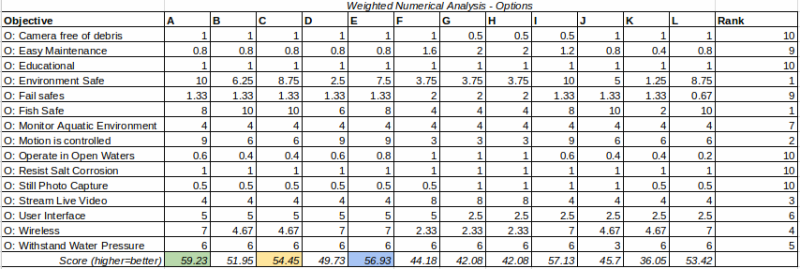
Weighted Best-in-Class Chart

Slide 43
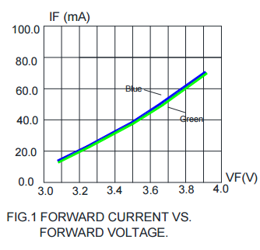
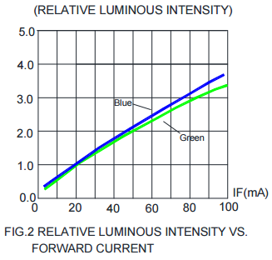
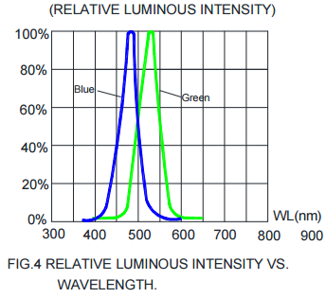
LED Figures

Slide 44
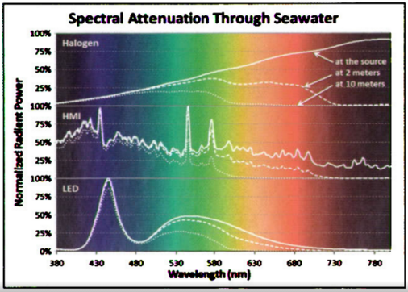
Attenuation of Light in Water

